Slide 1

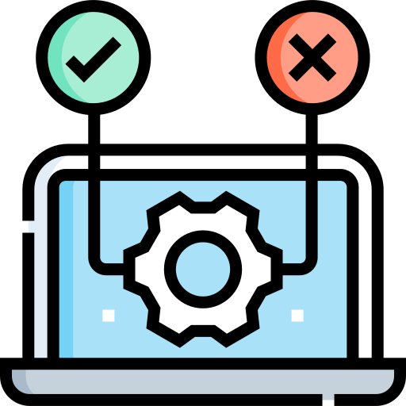

Topic: Exploring Diverse Testing Methods
Green University of Bangladesh
Department of Computer Science and Engineering
Software Testing & Quality Assurance Lab
CSE-454

Slide 2

PRESENTED BY
Joy Baidya
211002142
Nazrul Islam
211002144
Course Teacher: Sudip Chandra Ghoshal
Software Testing & Quality Assurance Lab
02

Slide 3
TABLE OF CONTENT
Introduction
Objectives
Types of Features We Tested
Motivation
Problem Domain
Functional
Non-Functional
Conclusion
Tools and Techniques
References
Types of Test We Performed
Software Testing & Quality Assurance Lab
03

Slide 4

Introduction
Software testing is a process of evaluating a software whether it meets its requirement as expected and works perfectly or not.
Software Testing & Quality Assurance Lab
04

Slide 5

To Explain Testing Methods.
To Showcase Results.
To Highlight Challenges.
To Emphasize Best Practices.
To Advocate for Quality Assurance.
Software Testing & Quality Assurance Lab
05

Slide 6

Motivation
Ensuring Quality
Reducing Risks
Enhancing User Experience
Professional Growth
Driving Innovation
Software Testing & Quality Assurance Lab
06

Slide 7




Tools and Techniques
Software Testing & Quality Assurance Lab
07

Slide 8
Types of Major Features We Tested
Pagination
Sign in
Signup
View Details
Navigation
Filtering
Searching
Software Testing & Quality Assurance Lab
08

Slide 9

Types of Major Features We Tested
Manual Test.
Automation Test.
API Test.
Security Test.
Performance Test:
Load Testing.
Stress Testing.
Endurance Testing.
Spik Testing.
Software Testing & Quality Assurance Lab
09

Slide 10
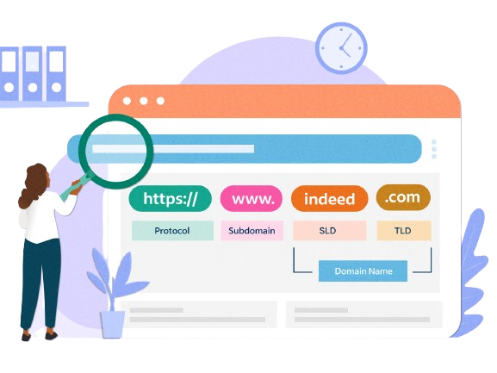
Problem Domain
Context of the Website.
Challenges to Address.
Need for Testing.
Objectives of Testing.
Software Testing & Quality Assurance Lab
10

Slide 11
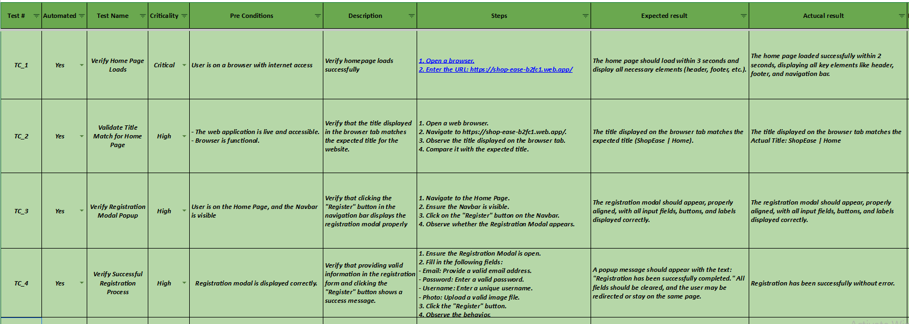

Manual Test Report
Software Testing & Quality Assurance Lab
11
Manual Test Case

Slide 12
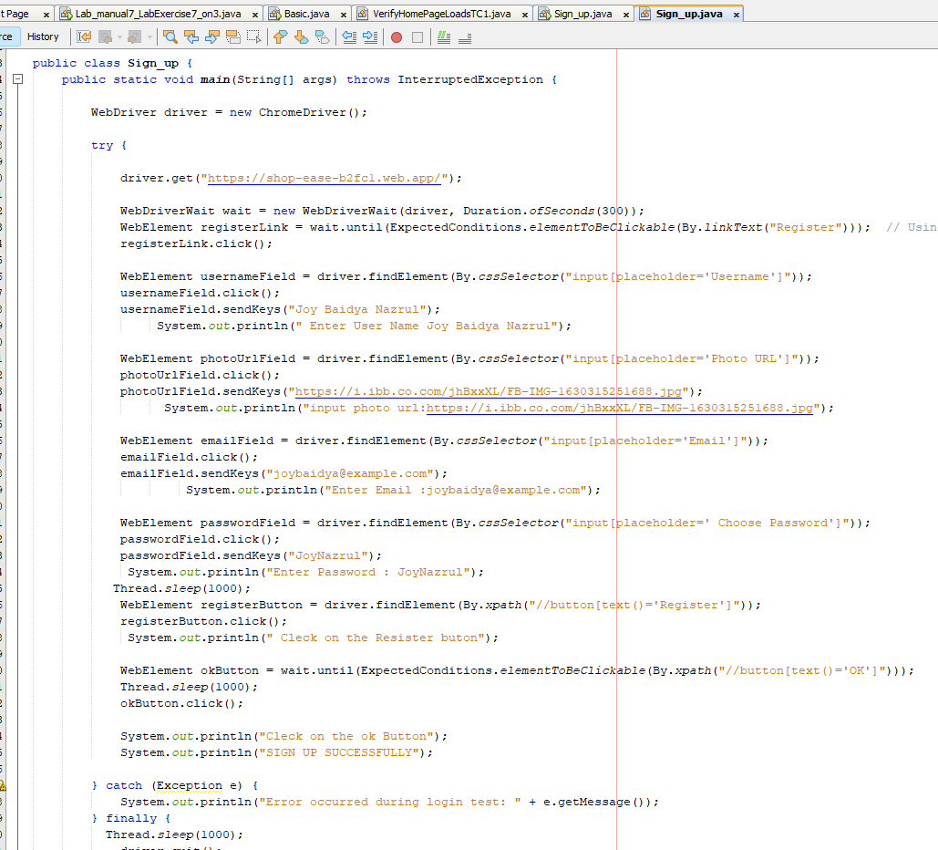
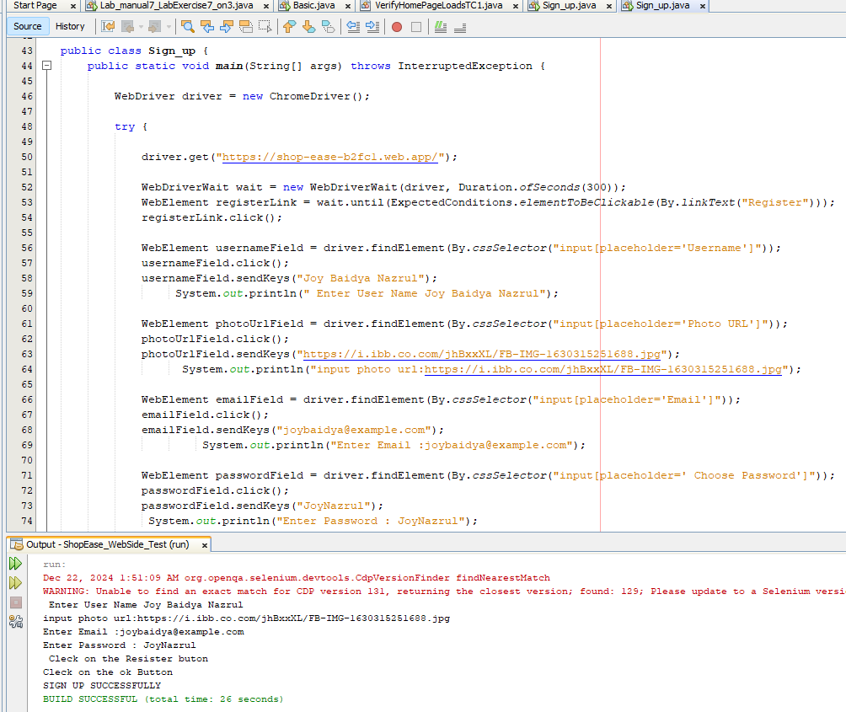
Automation Test
Software Testing & Quality Assurance Lab
12

Slide 13
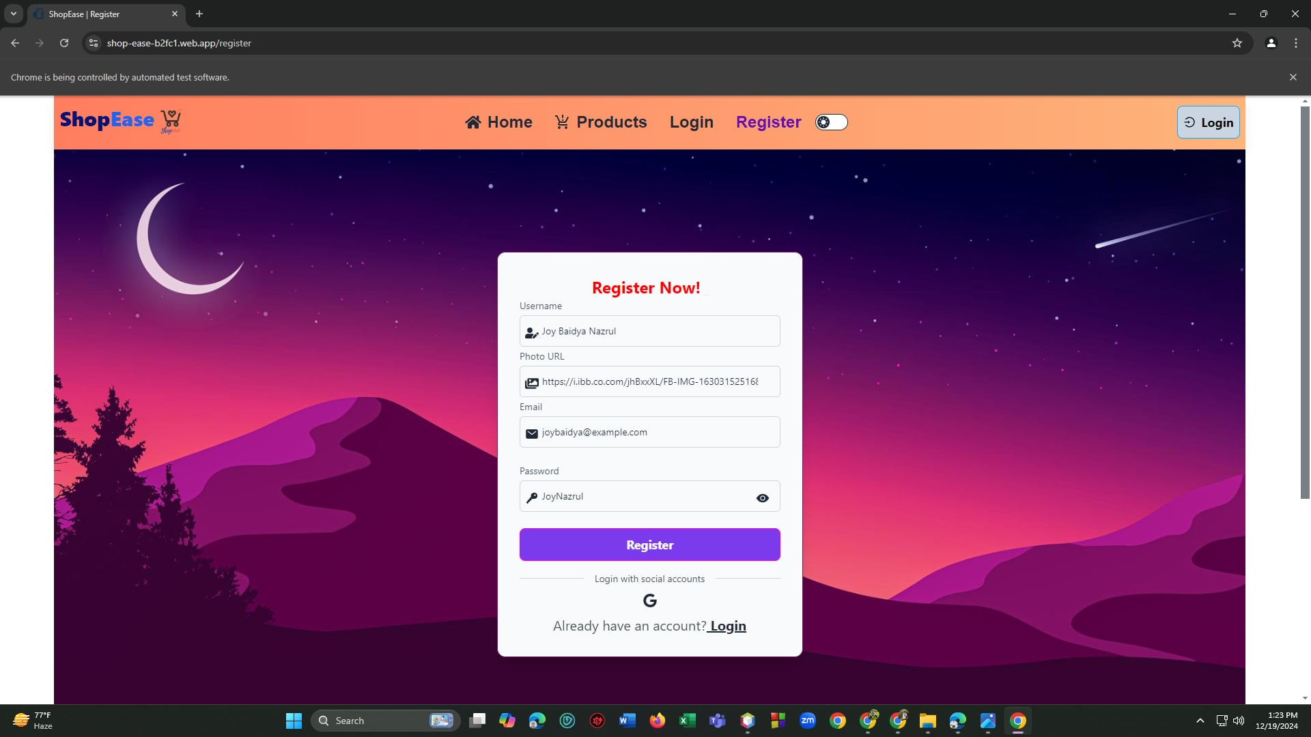
Automation Test
Software Testing & Quality Assurance
07

Slide 14
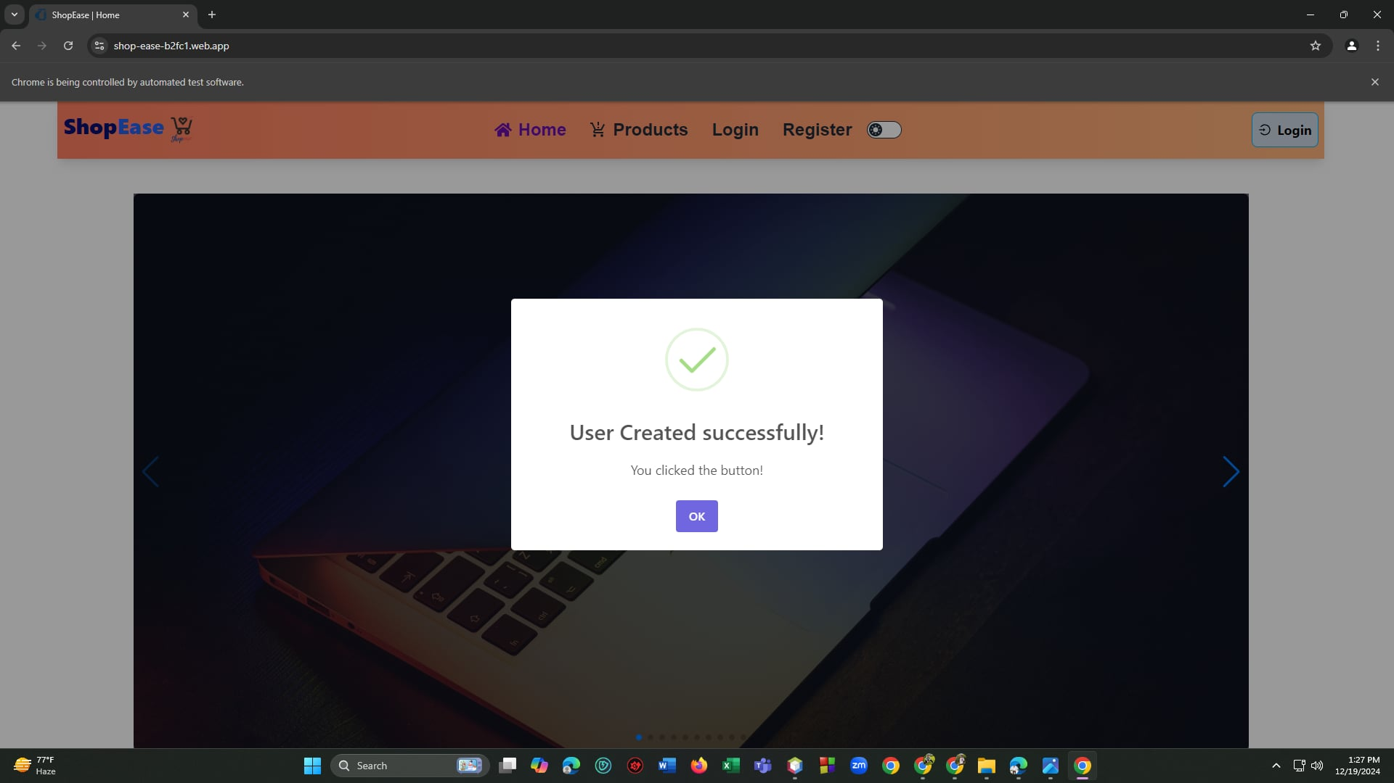
Performance Test
Software Testing & Quality Assurance
07

Slide 15
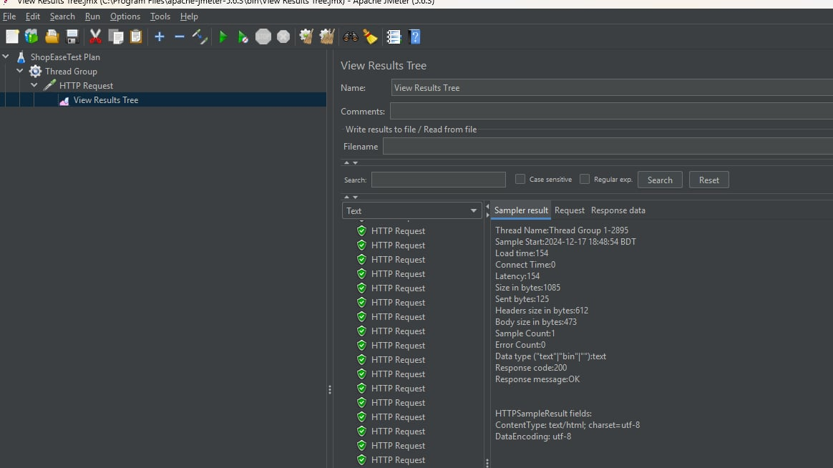
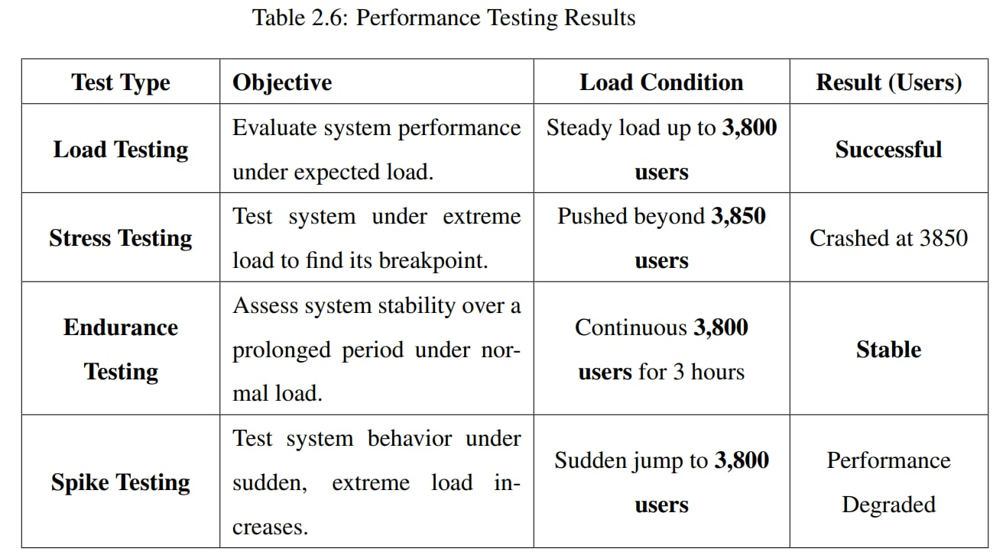
Performance Test
Software Testing & Quality Assurance Lab
15

Slide 16
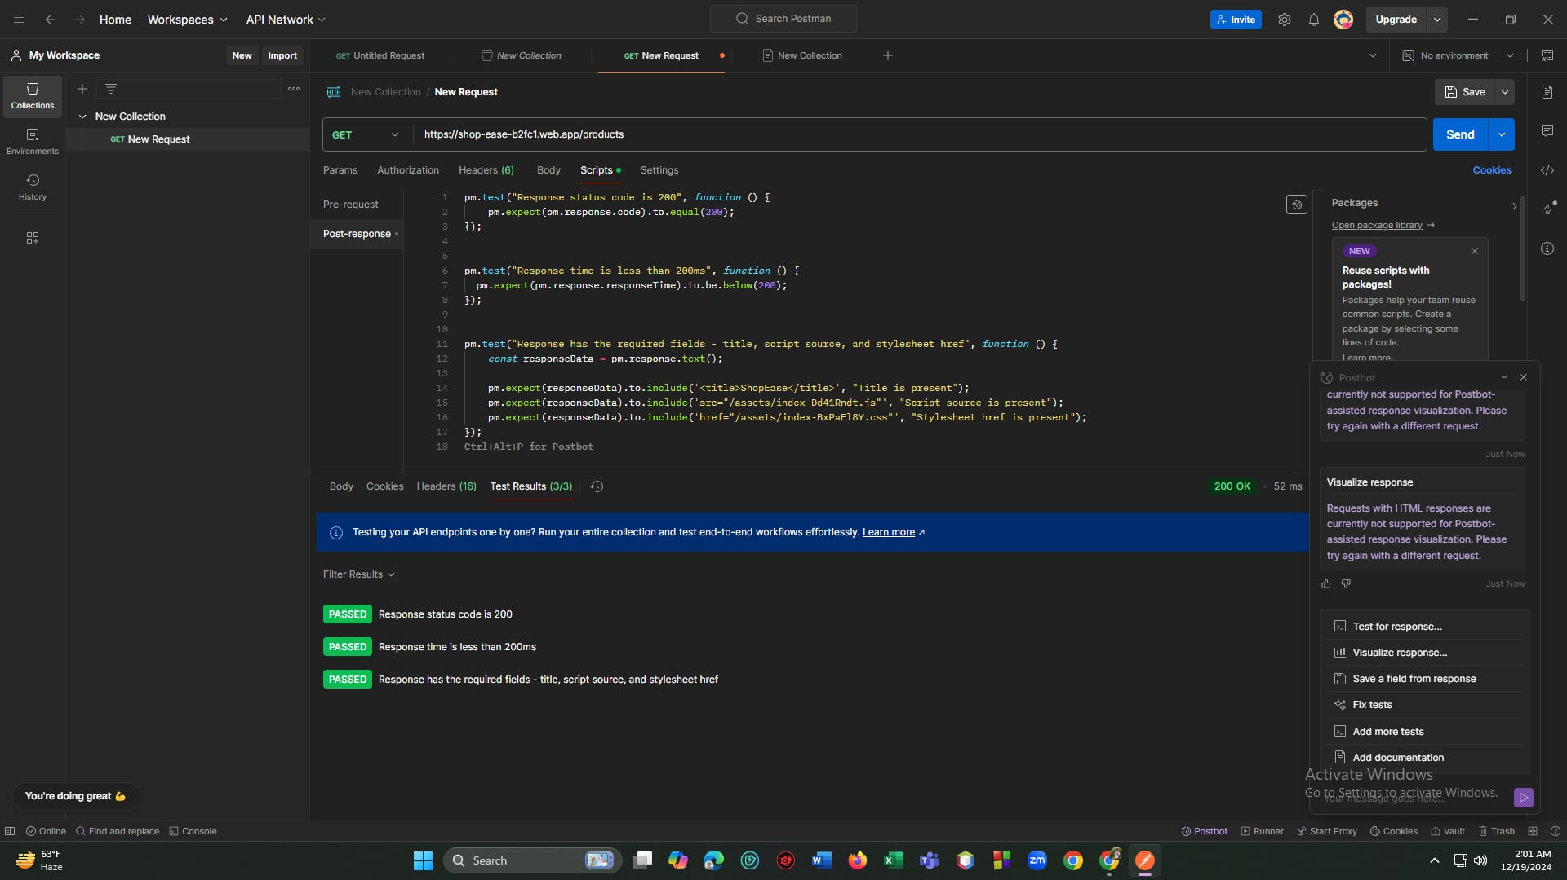
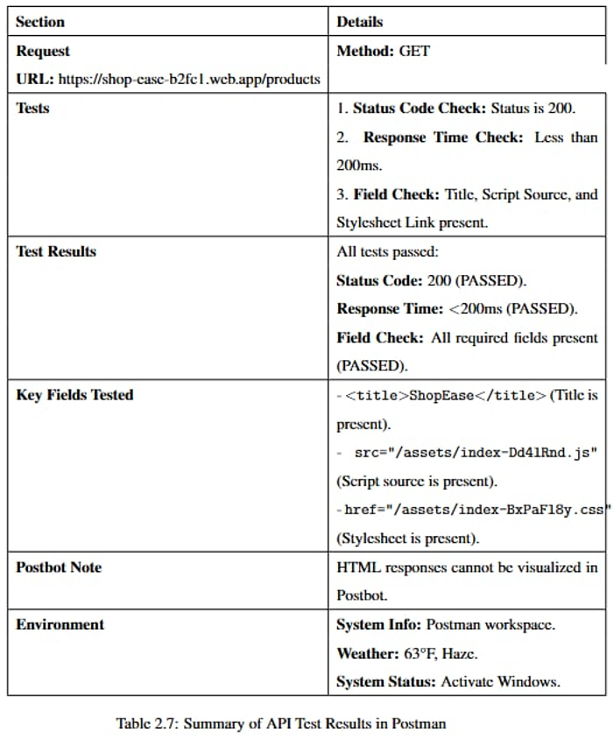
API Test
Software Testing & Quality Assurance Lab
16

Slide 17
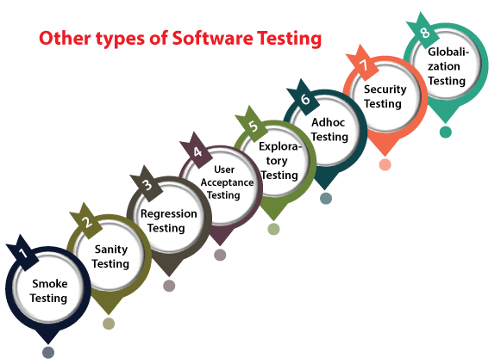
Software Testing & Quality Assurance Lab
17

Slide 18


Testing is a critical process in ensuring the functionality, reliability, and usability of websites.
Through automated, manual, functional, and non-functional testing, the website's quality was significantly enhanced, ensuring it meets user and business expectations.
Testing is not just a phase but an ongoing commitment to delivering excellence and maintaining user trust.
Software Testing & Quality Assurance Lab
18

Slide 19

References
1. Website: ShopeEase (E-commerce)
Link: https://shop-ease-b2fc1.web.app
2. Tools: Selenium
Description: A popular automated testing tool for web applications that supports multiple browsers and programming languages.
3. Book:
Title: Software Testing: A Craftsman's Approach.
Author: Paul C. Jorgensen.
Publisher: CRC Press, 2013.
Description: A comprehensive guide to software testing methodologies.
4. Project Report
Software Testing & Quality Assurance Lab
19

Slide 20

Software Testing & Quality Assurance Lab
End

